Slide 1
Weekly Update 5
Sarang Deb Saha

Slide 2
Overview-
Scraping FIR portal
Extracting relevant data from the FIRs
Using the ‘getallevents.py’ script for intersection data.
We still need permission for the API endpoint.
Notebook for analyzing the data we get from 3

Slide 3
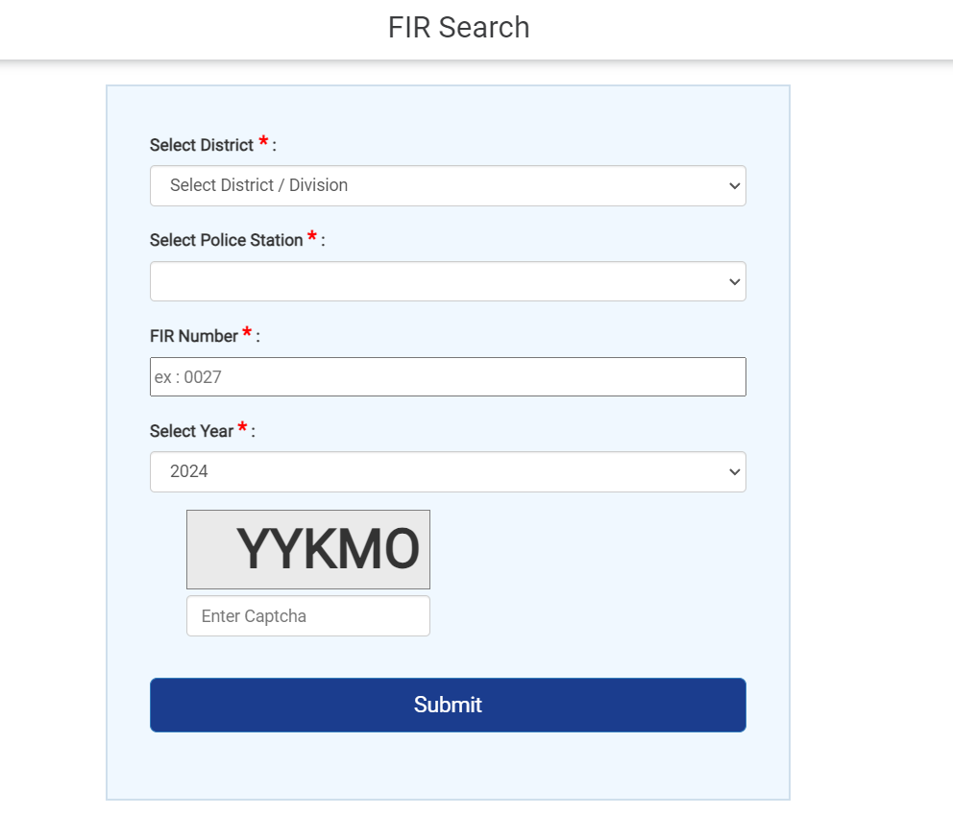
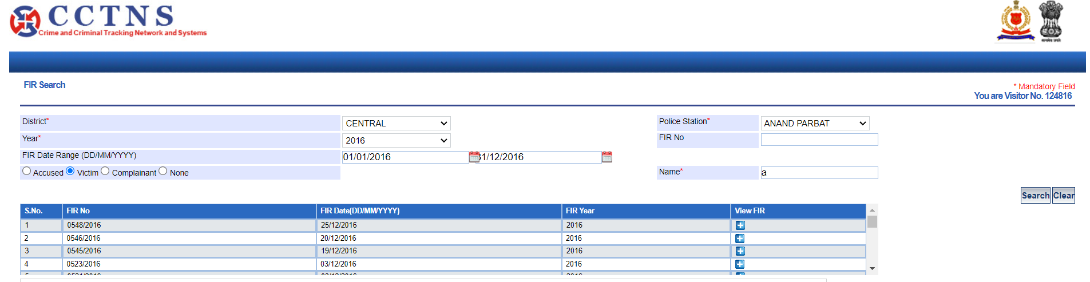
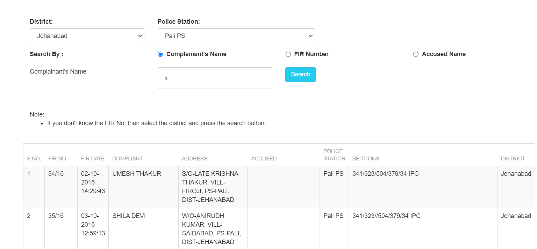
FIR Portal
Concerns regarding the website/portal security.
Delhi Police
Bihar Police
KSP

Slide 4
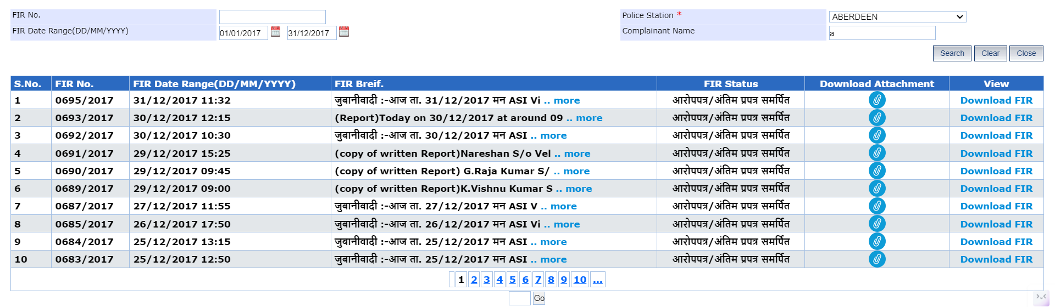
Andaman and Nicobar

Slide 5
2. Extracting relevant data from the FIRs
PS_id && Crime No.
Circle/Sub Division
PS_name
FIR Date
Act & Section
Day of occurrence
Date of Occurrence
Time of Occurence
Place of Occurence
Distance from PS
Victim_age
Victim_gender
Vehicle_Make
Vehicle_Year
Damage_value
Violation_details
Violation_nature
Violation_cause
Severity (in case of accident)
Number of Casualties
Fatality
Using the script

Slide 6
Extraction Techniques
Using Regex - PyPDF2, re
Using TextBox Coordinates - pdfquery, pandas
Using Neighboring Keywords
OCR

Slide 7
Additional features that can be extracted via 3rd party services
Latitude-Longitude by mapping the data
Weather at the time of incident
Type of road
Speed limit
Light Condition
Features that we might not get-
Road Surface Condition
LHS/RHS
Pedestrian_details

Slide 8
Types of Analysis:
Trend Analysis: Analyze the frequency of road accidents and violations over time (e.g., monthly, quarterly, yearly) to identify any patterns or trends.
Spatial Analysis: Explore the geographical distribution of accidents and violations using latitude-longitude coordinates to identify high-risk areas or intersections.
Demographic Analysis: Examine the demographics of victims, such as age and gender, to understand who is most affected by accidents and violations.
Vehicle Analysis: Investigate the types of vehicles involved, vehicle make, and year to identify any trends or patterns related to specific vehicle models.
Severity Analysis: Assess the severity of accidents based on damage value, number of casualties, and fatalities to understand the impact of accidents on individuals and infrastructure.
Temporal Analysis: Analyze the day of the week, time of occurrence, and weather conditions to identify when and under what conditions accidents are most likely to occur.
Correlation Analysis: Explore correlations between different variables (e.g., weather conditions and accident severity) to identify potential causal relationships.
FIR Response time: Analyze the time between the accident

Slide 9
Ideas for Predictive Models:
Accident Severity Prediction: A model to predict the severity of accidents based on factors such as the type of road, weather conditions, time of occurrence, vehicle characteristics, and violation details. This could help prioritize emergency response and allocate resources more effectively.
Violation Prediction: A model to predict the likelihood of different types of violations occurring based on factors such as location, time of day, weather conditions, and road type. This could aid law enforcement in targeting high-risk areas and implementing preventive measures.
Accident Hotspot Prediction: A model to predict areas with a high probability of accidents based on historical accident data, road characteristics, traffic patterns, and external factors such as weather conditions. This could assist in implementing targeted interventions to reduce accidents in high-risk areas.

